Slide 1
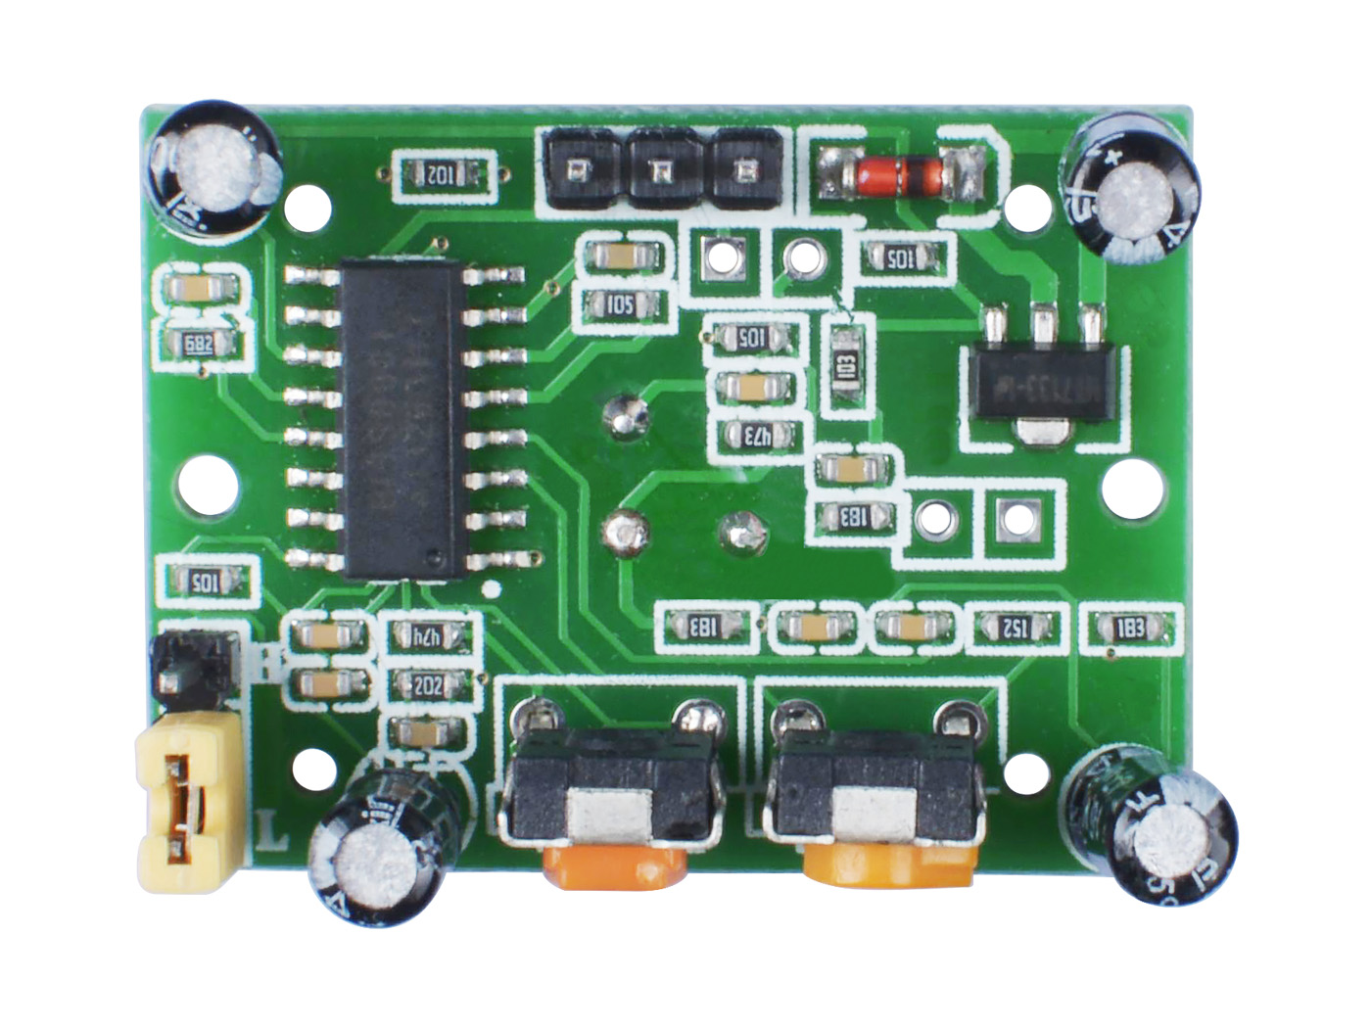
Delay Time
Adjustment
Distance
Adjustment
Trigger Mode
Switching
L
H
BISS0001
PIR Chip
VCC
OUT
GND
Delay Time Adjustment: Clockwise adjustment, high output time becomes longer, maximum 200s, minimum 8s
Distance Adjustment: Clockwise adjustment, the detection distance becomes longer, the max. is 7meters, the min. is 3m
Trigger Mode Swithing:
L Mode Use the jumper cap to connect the top two pins to become L mode, cann’t continuously triggered
H Mode Use the jumper cap to connect the two pins on the bottom to become H mode, which can be triggered continuously

